Slide 2
E

Slide 3
E

Slide 4
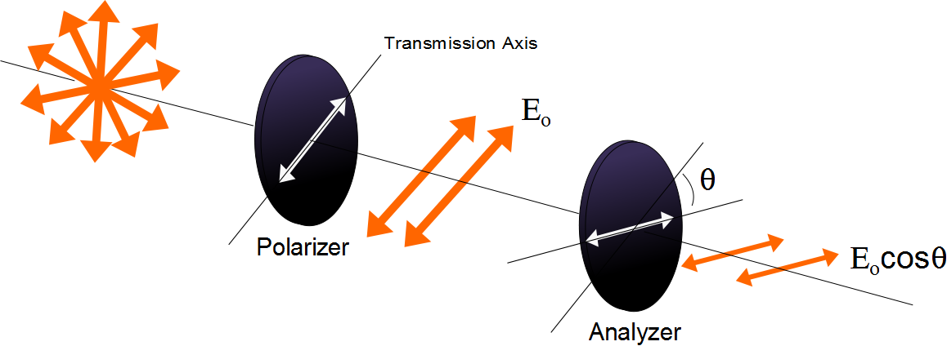

Slide 5
E
Incident Beam
Reflected Beam
θ₁
θ₁
n₁
n₂
Transmitted Beam
θ₂

Slide 6
E
Reflected Beam
Has only the
perpendicular
polarization
Incident Beam
θ_{b}
θ_{b}
n₁
90°
n₂
Transmitted Beam
θ₂

Slide 7
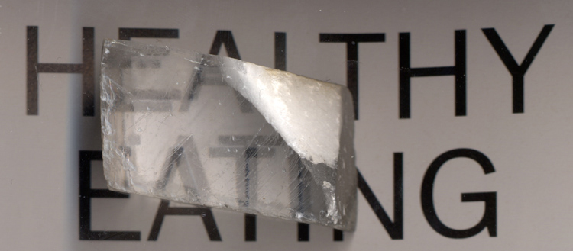

Slide 8
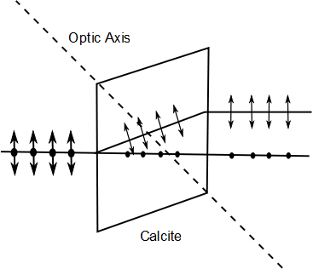
E-ray
Unpolarized Light
O-ray

Slide 9
Polarization by Double Refraction, Rays
The ordinary (O) ray is characterized by an index of refraction of n_{o}
This is the same in all directions
The second ray is the extraordinary (E) ray which travels at different speeds in different directions
Characterized by an index of refraction of n_{E} that varies with the direction of propagation

Slide 10
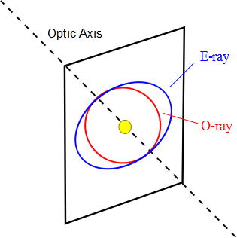

Slide 11

Optical Stress Analysis

Slide 12
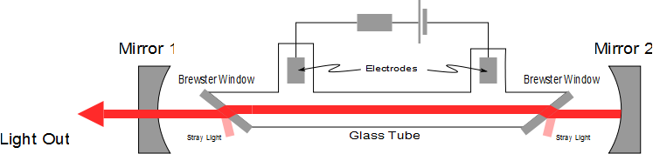
Laser Polarization

